Slide 1
Cause Of Deaths Report Submitted by Md Saleem A Patel.

Slide 2
Content :-
In this Dataset, we have Historical Data of different cause of deaths for all ages around the World. The key features of this Dataset are: Meningitis, Alzheimer's Disease and Other Dementias, Parkinson's Disease, Nutritional Deficiencies, Malaria, Drowning, Interpersonal Violence, Maternal Disorders, HIV/AIDS, Drug Use Disorders, Tuberculosis, Cardiovascular Diseases, Lower Respiratory Infections, Neonatal Disorders, Alcohol Use Disorders, Self-harm, Exposure to Forces of Nature, Diarrheal Diseases, Environmental Heat and Cold Exposure, Neoplasms, Conflict and Terrorism, Diabetes Mellitus, Chronic Kidney Disease, Poisonings, Protein-Energy Malnutrition, Road Injuries, Chronic Respiratory Diseases, Cirrhosis and Other Chronic Liver Diseases, Digestive Diseases, Fire, Heat, and Hot Substances, Acute Hepatitis.

Slide 3
IMPORTING IMPORTANT LIBARARIES:- import pandas as pd import numpy as np import matplotlib.pyplot as plt import seaborn as sns import pickle import warnings warnings.filterwarnings('ignore')

Slide 4
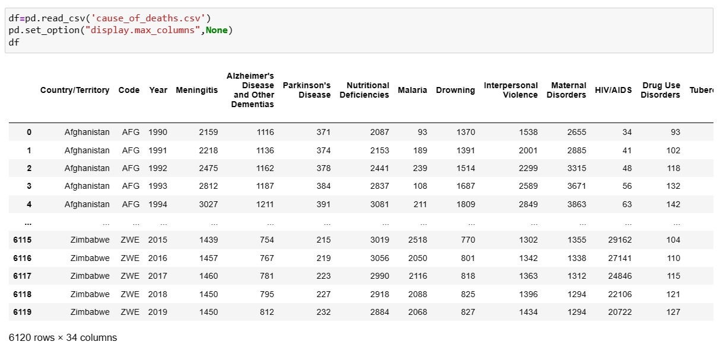
IMPORTING THE DATASET WITH DISPLAY MAX COLUMNS AS THERE ARE 34 COLUMNS IN THE DATASET :-

Slide 5
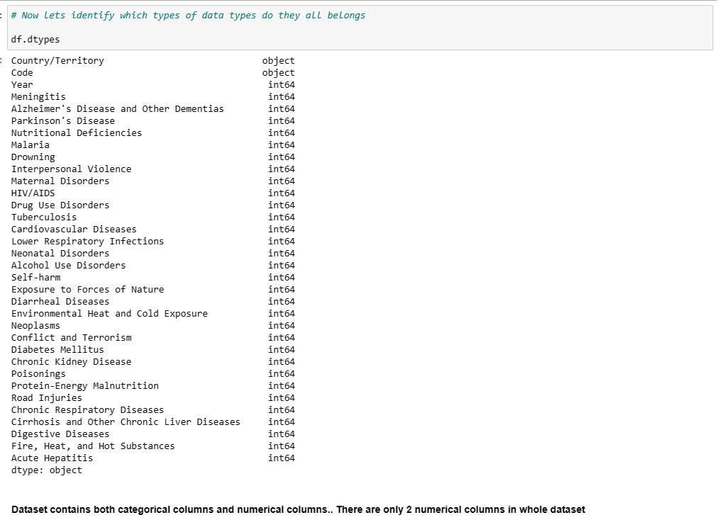
HERE WE CAN SEE THAT THERE ARE 2 OBJECT COLUMNS AND REST ALL THE OTHER COLUMNS ARE NUMERICAL COLUMNS.

Slide 6
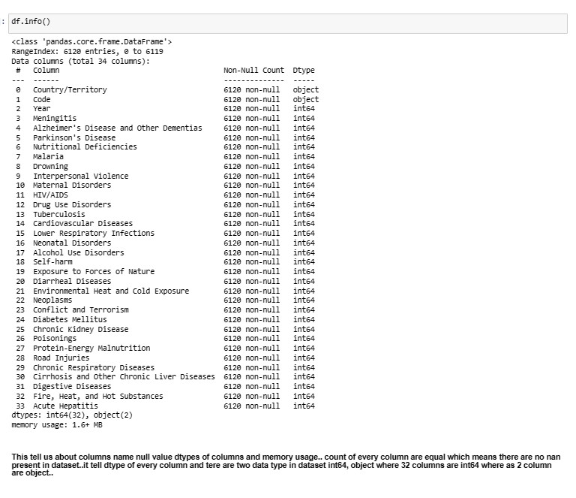
LETS CHECK THE INFO OF THE DATASET AND HERE WE GET TO KNOW ABOUT THE DATA TYPE AND COUNTS OF THE COLUMN:-

Slide 7
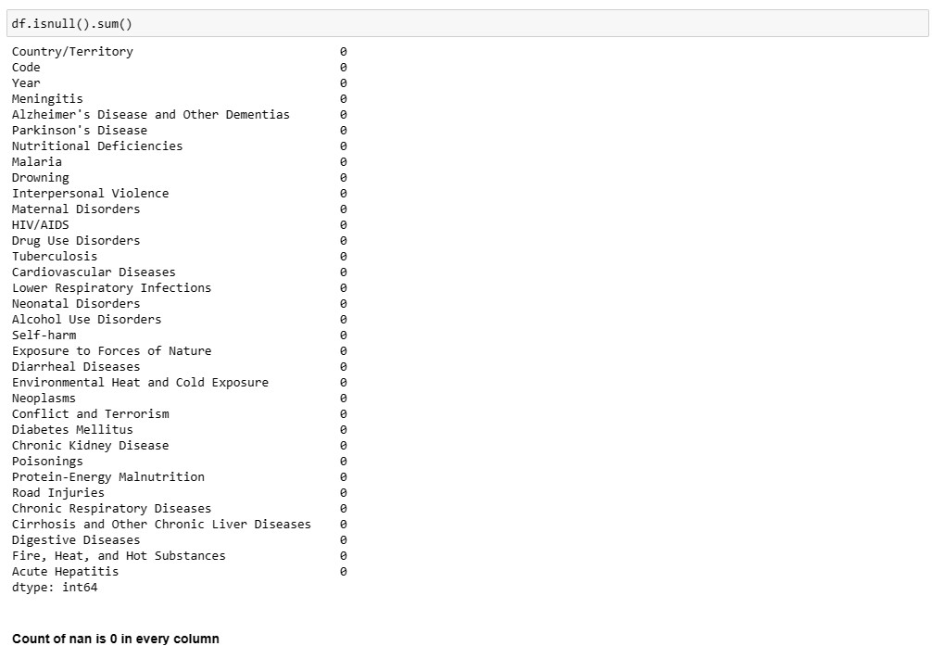
LETS CHECK NULL VALUES IN THE DATASET:-

Slide 8
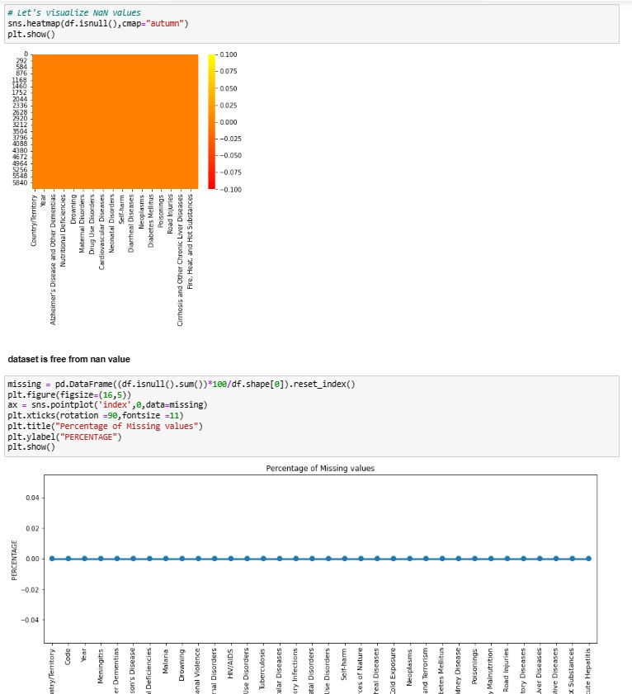
HERE WE CAN SEE THAT 0 NAN VALUES ARE PRESENT IN THE DATASET.

Slide 9
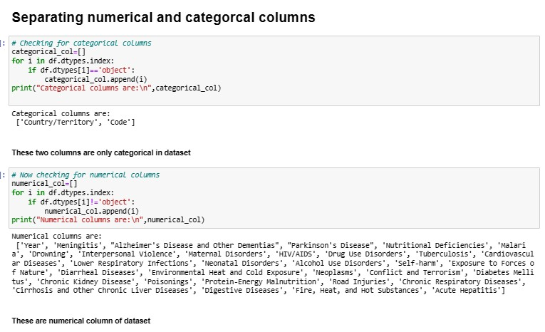
SEPRATING CATAGORICAL AND NUMERICAL COLUMNS FROM THE DATASET :-
AS TOLD ABOVE WE KNOW THAT WE HAVE 2 CATAGORICAL COLUMNS OUT OF 34 COLUMNS AND REST ALL 32 COLUMNS ARE NUMERICAL COLUMNS.

Slide 10
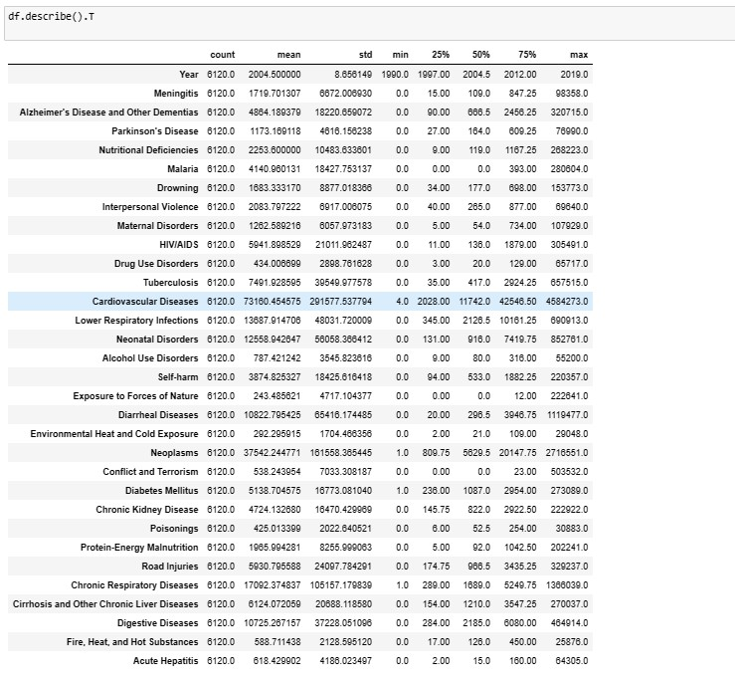
LETS DESCRIBE THE DATASET:-
Here we have described the whole dataset by DESCRIBE command .
We can see the count of all the columns that is 6120 which means no Null value is present in the dataset.
We can see the mean and standard deviation of all the Numeric columns in the dataset.
We can see the Min and Max from all the columns.
We can see Quartiles over here too

Slide 11
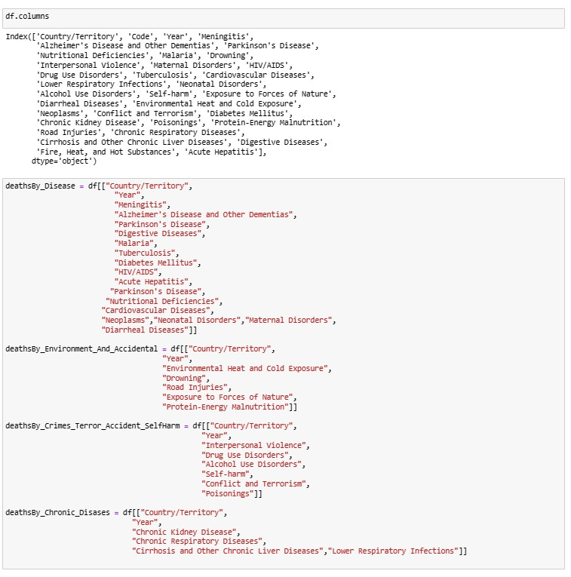
VISUALIZATIONS:
NOW LET’S DIVIDE ALL THE FACTORS OF DEATH INTO 4 CATAGORIES :-

Slide 12
THESE 4 CATAGORIES ARE :-
DEATH BY DISEASES
DEATH BY ENVIORNMENT AND ACCIDENT.
DEATH BY CRIME
,TERROR,SELF-HARM AND ACCIDENT.
DEATH BY CRONIC DISEASES.
NOW DO THE ANALYSIS AS PER THE DEATH BY
DISEASES

Slide 13
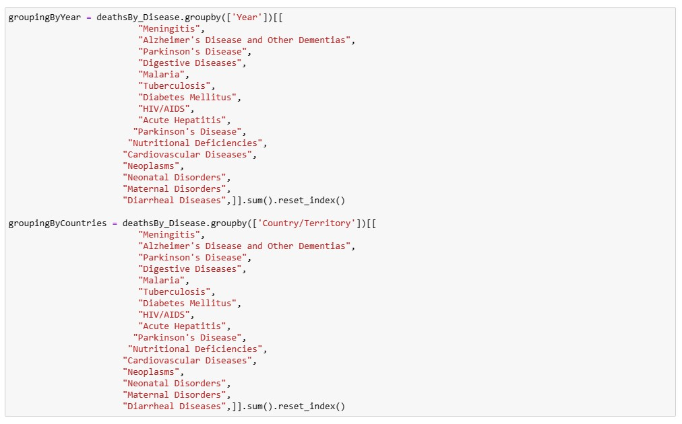
HERE I HAVE DONE GROUPING OF YEAR AND COUNTRIES ON THE BASIS OF DISEASES .

Slide 14
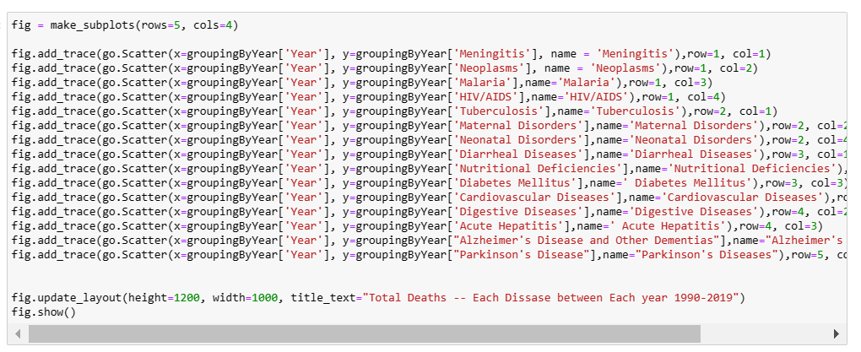
NOW DO PLOTTING OF DEATH BY DISEASES:-

Slide 15
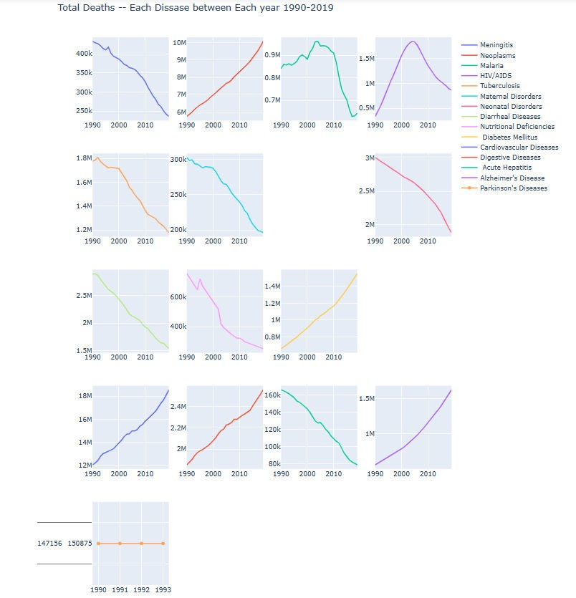
This is Plot shows how much Death has taken places by Diseases In all the year since 1990- 2019.

Slide 16
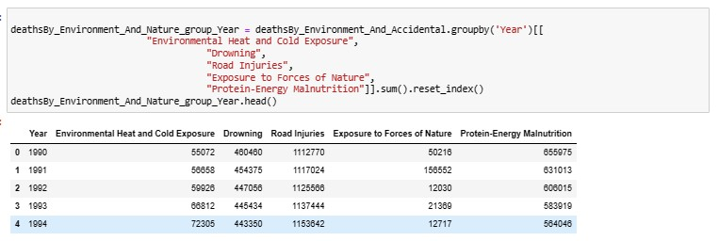
NOW LET’S SEE DEATHS TAKEN PLACE BY ENVIORNMENT AND ACCIDENT.
I HAVE DONE GROUPBY OF ALL THE DEATH ACCORDING TO YEAR WHICH FALLS UNDER THIS CATEGORY.

Slide 17
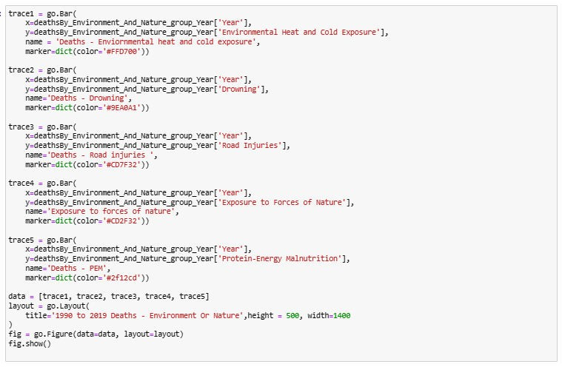
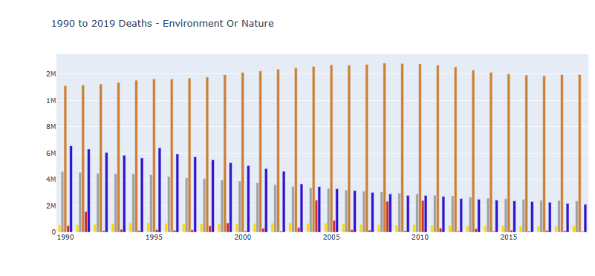

Slide 18
Here following colour is representing following columns :-
Yellow:- Environmental Heat and Cold Exposure
Grey :- Deaths - Drowning
Orange :- Road Injuries
Blue :- Protein-Energy Malnutrition(PEM)
This plot shows the total number of deaths caused by Environment_And_Accidental in year 1990 TO 2019. Here we can notice the least and the max death that took place in all the 4 categories in all the given year.

Slide 19
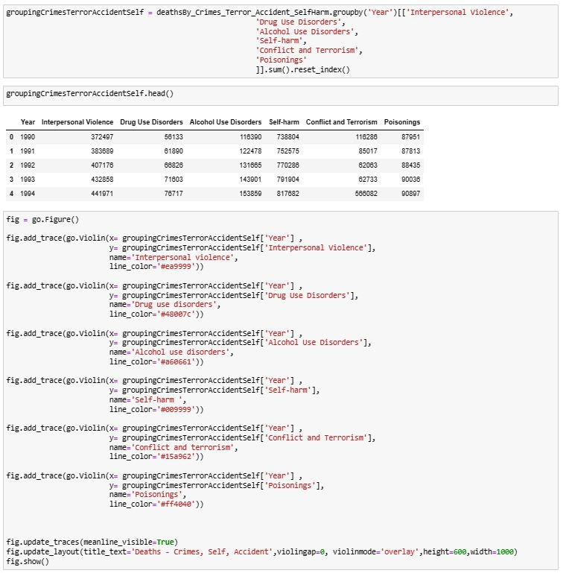
DEATH BY CRIME , TERROR
,SELF-HARM AND ACCIDENT.

Slide 20
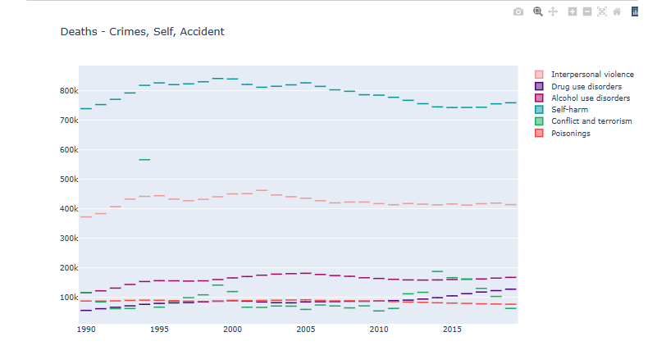
We can clearly see in this plot which shows CRIMES_TERROR_ACCIDENT_SELF-HARM and here
come to know that in all the years the maximum death have
been taken place by Conflicts and Terrorism and the max death was in between 1990 and 2000.
Poisoning seems to be constant in all the years.
The second highest death has taken place by Interpersonal violence
And rest all the case of seems to be under 200k in all the given years.

Slide 21
CONCLUSION
Total rows 6120 and 34 columns in the dataset.
I found out that there are many diseases which continuously increasing such as Neoplasms, HIV/AIDS, Diabetes, Cardiovascular Diseases, Digestive disorder and Alzheimer
I Found out that there are many diseases which are continuously decreasing too such as Acute Hepatitis, Diarrheal Diseases, Nutritional Diseases and Meningitis
Parkinson Diseases seems to be constants till 1990 to 1993 after that no data is present for the same.
We can see that in all the given years i.e. 1990 to 2019, Road accident have taken Maximum life’s and the least can death can be seen in Exposure to force of Nature
In case of Death by crime, self-harm and Accident -> Maximum death have been taken place by Conflict and Terrorism and the second highest death have been recorded by -Interpersonal Violence.
Rest all other factors of death are under 200k which can be even further minimized
ALL THE GOVERNMENT AND CONCERNED BODIES SHOULD TAKE RESONABLE STEP TO ENSURE THAT ALL THE AREAS WITH MAXIMUM DEATHS CAN BE MINIMIZED AND PROPER ACTION SHOULD BE TAKEN
IN CASE OF CONFLICT &TERRIOSM AND INTERPERSONAL VIOLENCE SO THAT IT SHOULD BE REDUCED TO MINIMAL.

